Slide 1


Evolutionary
AutoML
DR. EMMANUEL KIEFFER
DR. BOONYARIT CHANGAIVAL
MOAD HANI
YANN HOFFMANN
THI HUYEN TRANG HOANG
DR. EMMANUEL KIEFFER
DR. BOONYARIT CHANGAIVAL
29/05/2020

Slide 2
Outline
Introduction
Experimental Approach
Results and Analysis
Contribution and Future Works

Slide 3

PROBLEMATIC
How to create a universal language for CNNs?

Slide 4
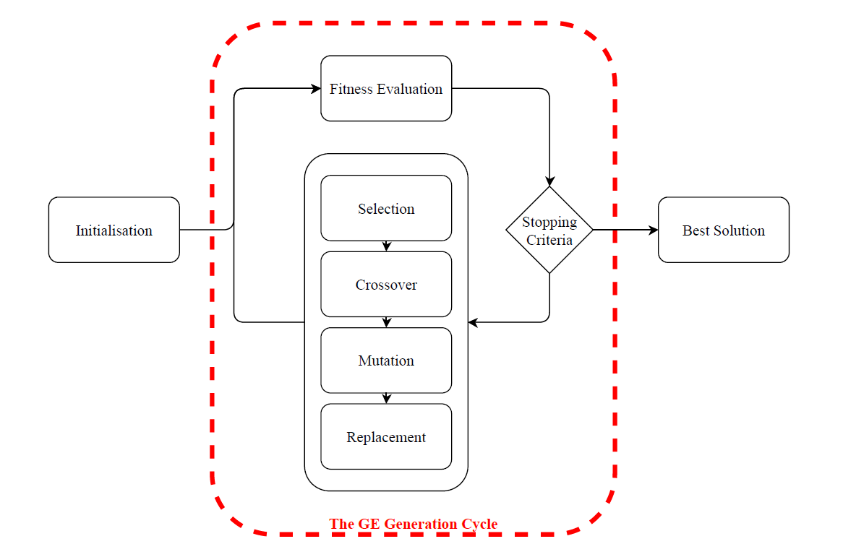
Introduction
Why is GE the proper metaheuristic?
How does it work?
Notes:
Improving the IEE

Slide 5
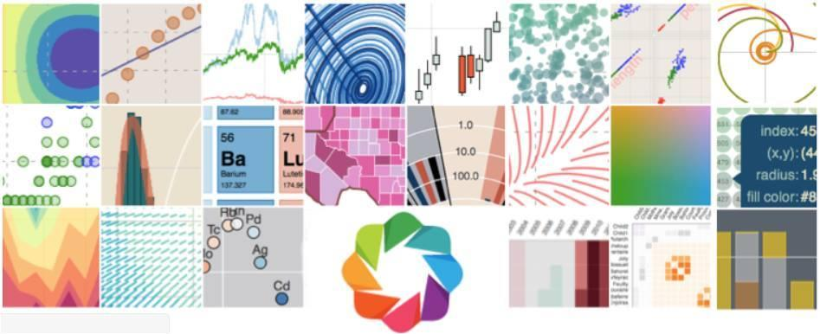
Experimental Approach
Notes:
© Copyright Showeet.com – Free PowerPoint Templates

Slide 6
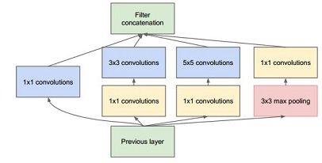
Proposed grammars
Grammar | Control Grammar IEEE | Evol Grammar | Control Grammar | Inception v1 | Inception v2
Varying strides | No | Yes | No | No | No
Batch normalization | No | Yes | No | No | No
Varying batch size | No | Yes | No | No | No
Global Pooling | No | Yes | No | No | No
Kernel Variation | Yes | Yes | No | Yes | Yes
Filter Variation | Yes | Yes | No | No | Yes
Inception Unit | No | No | Yes | Yes | Yes

Slide 7
Experimental Setting
PonyGE2 parameters
Step 1: Evolution of Grammars
Runs per grammar: 5
600 max evaluations with
Generation: 20
Population Size: 30
Tournament Selection
Variable-onepoint Crossover
Int-flip-per-codon Mutation
Epochs: 50 (CNN parameter)
Step 2: Confirmation Training
Number of runs: 20
Epochs: 500 (CNN parameter)
Performance Optimization
Run all experiments on GPU nodes (HPC)
iris-[169-186] 72 GPU
4 Tesla V100 [5120c CUDA + 640c Tensor] 16GB
iris-[191-196] 24 GPU
Twice the memory 32GB
=> However, time and resource are limited
https://hpc.uni.lu/systems/iris/#computing-capacity

Slide 8
Results Analysis
Notes:
© Copyright Showeet.com – Free PowerPoint Templates

Slide 9
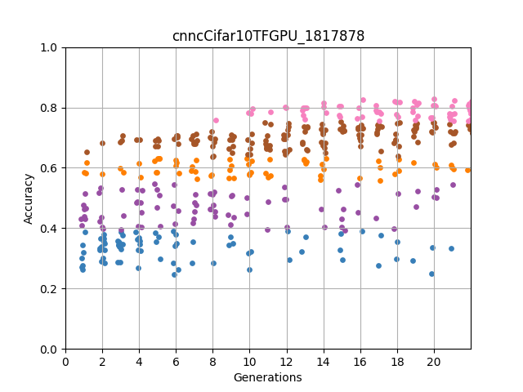
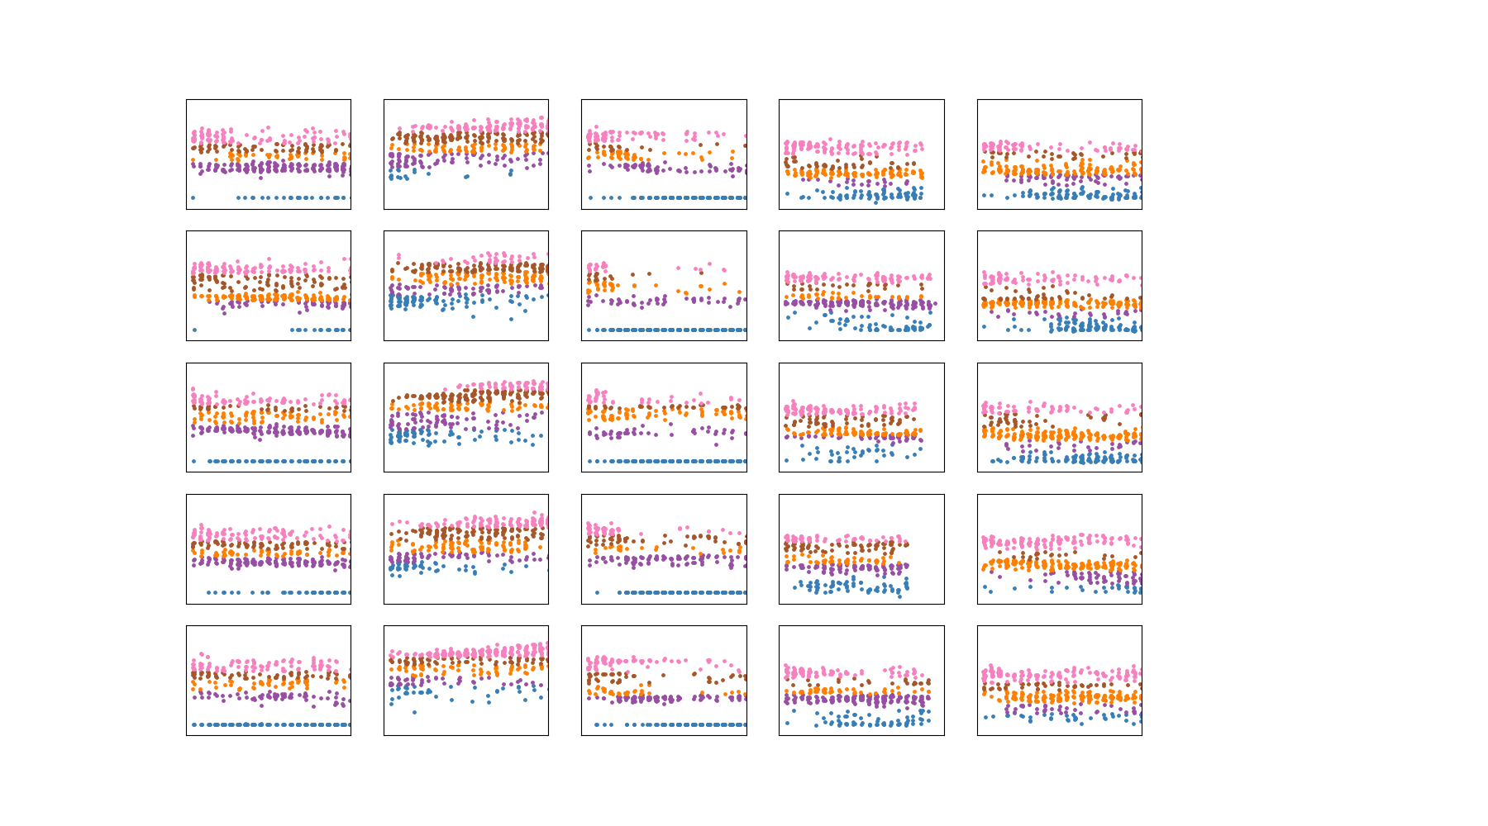
The results: Part I - Grammar Evolution
Control
Evo X
Control
Inception
Observations:
Speciation Phenomenon
Trend
0.1 Band property
Comparison

Slide 10
Experimental Results
 | Best Fitness | Average Fitness | Average Time
IEEE Control Grammar | 0.779 | 0.7705 | 1203 min
Evol Grammar | 0.851 | 0.8373 | 1624 min
Control Grammar | 0.75 | 0.73 | 2880 min
Inception v1 | 0.65 | 0.63 | 5575 min
Inception v2 | 0.64 | 0.61 | 6233 min

Slide 11
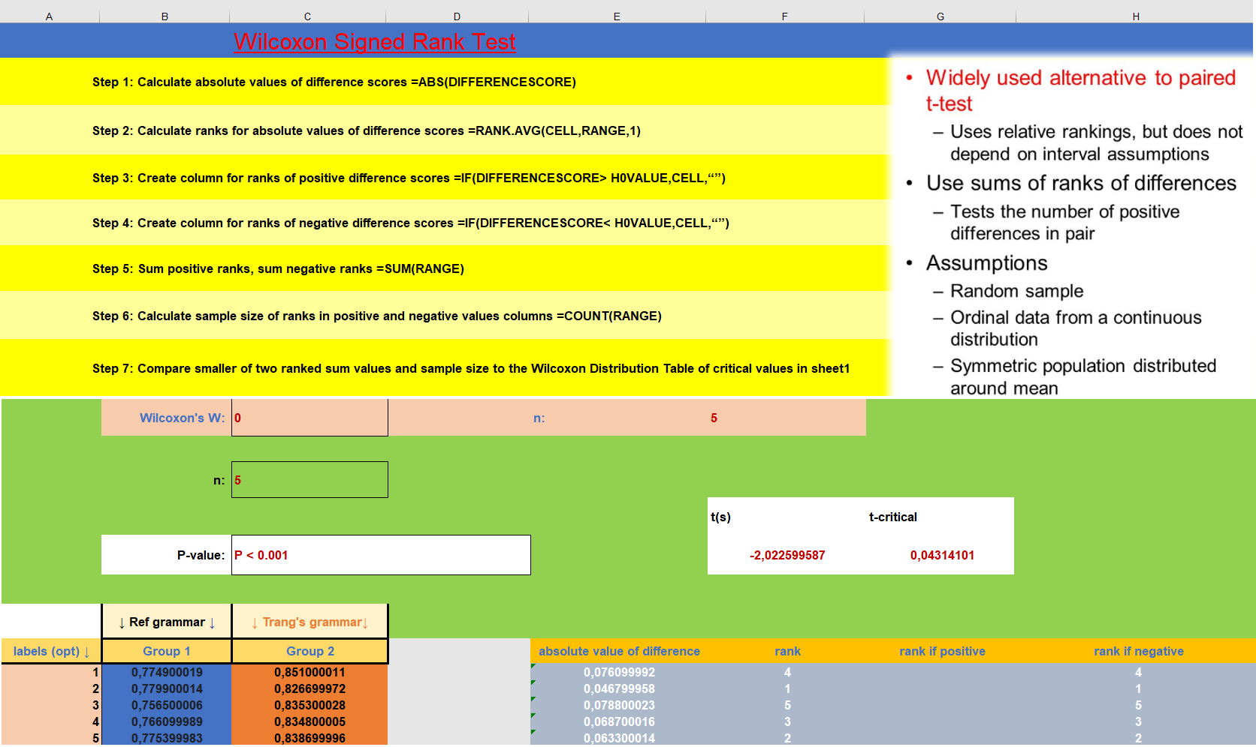
Understanding:
Why evol approach worked well?
How can we improve inception model?
Wilcoxon Signed Rank Test
Rationale behind Wilcoxon for GE?
Choose H0
Non-parametric test
nobs=5; Pvalue=P<0.001

Slide 12
The results: Part II - Evolved CNN
CNN
Winners | Fitness after 50 epochs | Average fitness over 20 runs | Fitness after 500 epochs | Number of parameters
IEEE Control Grammar | 0.779 | 0.78 | 0.78 | 180,554
Evol Grammar | 0.851 | 0.8584 | 0.8628 | 2,290,354
Control Grammar | 0.75 | 0.76 | 0.78 | 300,381
Inception v1 | 0.65 | 0.72 | 0.74 | 2,325,731
Inception v2 | 0.64 | 0.71 | 0.76 | 1,821,878

Slide 13
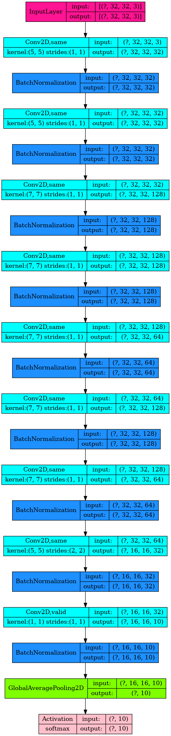
Best CNN - An AI generated by an AI?
model = Sequential()
model.add(Conv2D(32, (5, 5), activation='selu', strides=1, padding='same'))
model.add(BatchNormalization())
model.add(Conv2D(32, (5, 5), activation='selu', strides=1, padding='same'))
model.add(BatchNormalization())
model.add(Conv2D(128, (7, 7), activation='selu', strides=1, padding='same'))
model.add(BatchNormalization())
model.add(Conv2D(128, (7, 7), activation='elu', strides=1, padding='same'))
model.add(BatchNormalization())
model.add(Conv2D(64, (7, 7), activation='selu', strides=1, padding='same'))
model.add(BatchNormalization())
model.add(Conv2D(128, (7, 7), activation='elu', strides=1, padding='same'))
model.add(BatchNormalization())
model.add(Conv2D(64, (7, 7), activation='selu', strides=1, padding='same'))
model.add(BatchNormalization())
model.add(Conv2D(32, (5, 5), activation='elu', strides=2, padding='same'))
model.add(BatchNormalization())
model.add(Conv2D(num_classes, (1, 1), activation='elu', strides=1, padding='valid'))
model.add(BatchNormalization())
model.add(GlobalAveragePooling2D())
model.add(Activation('softmax'))

Slide 14
Conclusion
Notes:
© Copyright Showeet.com – Free PowerPoint Templates

Slide 15
Takeaway
Grammar Evolution
Very sensitive to initialization
Haphazardous Convergence
Excellent results
Future works
Construction and selection of layers
Super blocks
Grammars
Internal Structure
Reliant on building blocks
CNN
Reasonable size
High performance

Slide 16

THANK YOU!
https://gitlab.uni.lu/ekieffer/evoautoml
Photo credit: HypnoArt via Pixabay
(Creative Commons Zero license)
Notes:
© Copyright Showeet.com – Free PowerPoint Templates

Slide 17
Options for PonyGE2 parameters
INITIALIZATION | uniform_tree | rhh | PI_grow https://github.com/PonyGE/PonyGE2/wiki/Initialisation
SELECTION | tournament | truncation | nsga2 https://github.com/PonyGE/PonyGE2/wiki/Selection
CROSSOVER | fixed_onepoint | fixed_twopoint | variable_onepoint | variable_twopoint | subtree https://github.com/PonyGE/PonyGE2/wiki/Variation#crossover
MUTATION | int_flip_per_codon | int_flip_per_ind | subtree https://github.com/PonyGE/PonyGE2/wiki/Variation#mutation

Slide 18
Evo Grammar - Sequential Architecture
<cnn> ::= <input><c_layer><last>
<input> ::= Input()
<c_layer> ::= <conv> | <conv><c_layer>
<last> ::= Conv2D(num_classes, (1,1), <activation>, <strides>, <padding>)
BatchNormalization() <gpool> Activation(‘softmax’)
<conv> ::= Conv2D(<filters>, <k_size>, <activation>, <strides>, <padding>)
BatchNormalization()
<gpool> ::= <gmaxpool> | <gavgpool>
<activation> ::= "'relu'" | "'selu'" | "'elu'"
<padding> ::= "'valid'" | "'same'"
<filters> ::= 16 | 32 | 64 | 128
<k_size> ::= (3,3) | (5,5) | (7,7)
<b_size> ::= 32 | 64 | 128 | 256
<strides> ::= 1 | 2

